Slide 1
Purchase Requests
Notes:
Introduction
Who you are
The Class
What will we do in the class

Slide 2
Defining a Purchase Request
A Purchase Request is a document that details what goods or services you would like to purchase for the future.
Notes:
Your requisition to purchase goods and services
Capture the approvals – Once request is approved you say what you want to purchase
PR goes to contracting officer
PR tells what you want to order and the funding

Slide 3
Standard Purchasing Chain
Invoice
M7/M6
Request
PR
Order
GP
QP, FP, TP
OP
XP
PJ, PN, PP
Payment
Authorization
P7/P6
Receipt
RW/RK
Notes:
PR is “Copied Forward” to the GP
Once it is an Order, it is an Obligation. (Undelivered Order)
Once Order-Invoice-Receipt match Pegasys Pays the Vendor- money is no longer GSA’s
If you do not like it or do not want it, do not do a Receipt. Otherwise, Pegasys will pay it

Slide 4
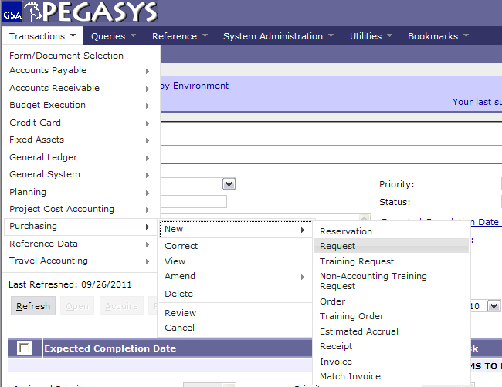
Creating Purchase Requests
Select :
- Transactions
- Purchasing
- New
- Request
Notes:
Training Request= TR
Not used very often, usually only for Prepaid Training

Slide 5
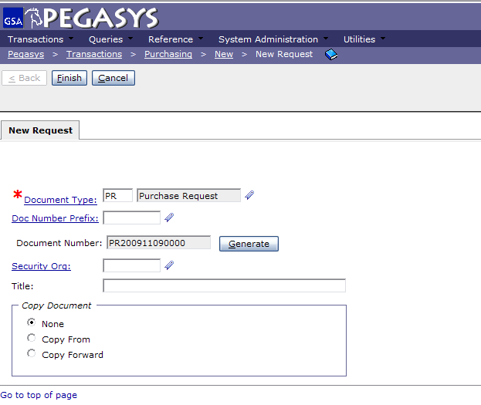
Creating Purchase Requests (2)
Enter PR
- Press Tab
- Click Generate
- Click Finish
Notes:
PR is universal across all GSA offices
Document number is composed of the Date and the last four numbers are a sequence

Slide 6
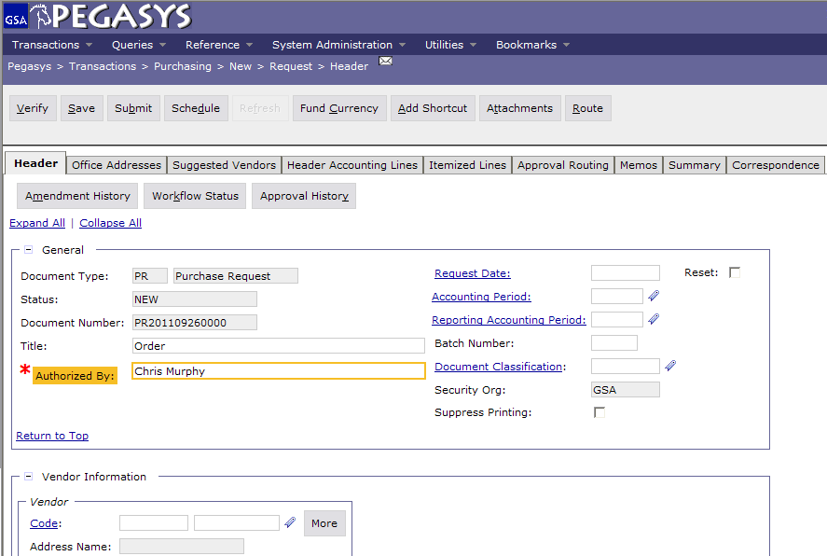
Header Tab
Enter :
- Title
- Authorized by
Notes:
Does not need a vendor (contracting officer researches to find best price)
Title is optional but highly recommended. If you search all of your PR’s whatever you write in Title will be displayed.
Requested by is who wants it, if you’re ordering for the whole office you want to know who it is going to.

Slide 7
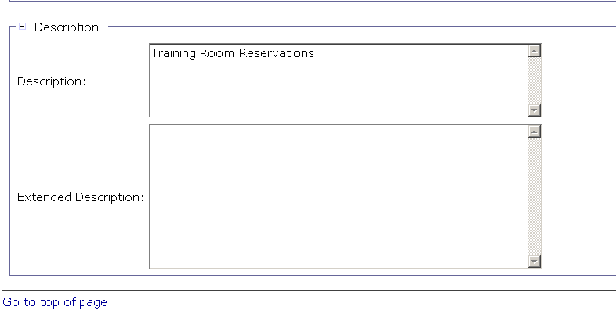
Description
Enter :
- Description
Notes:
Description is displayed on the Transaction Summary Report

Slide 8
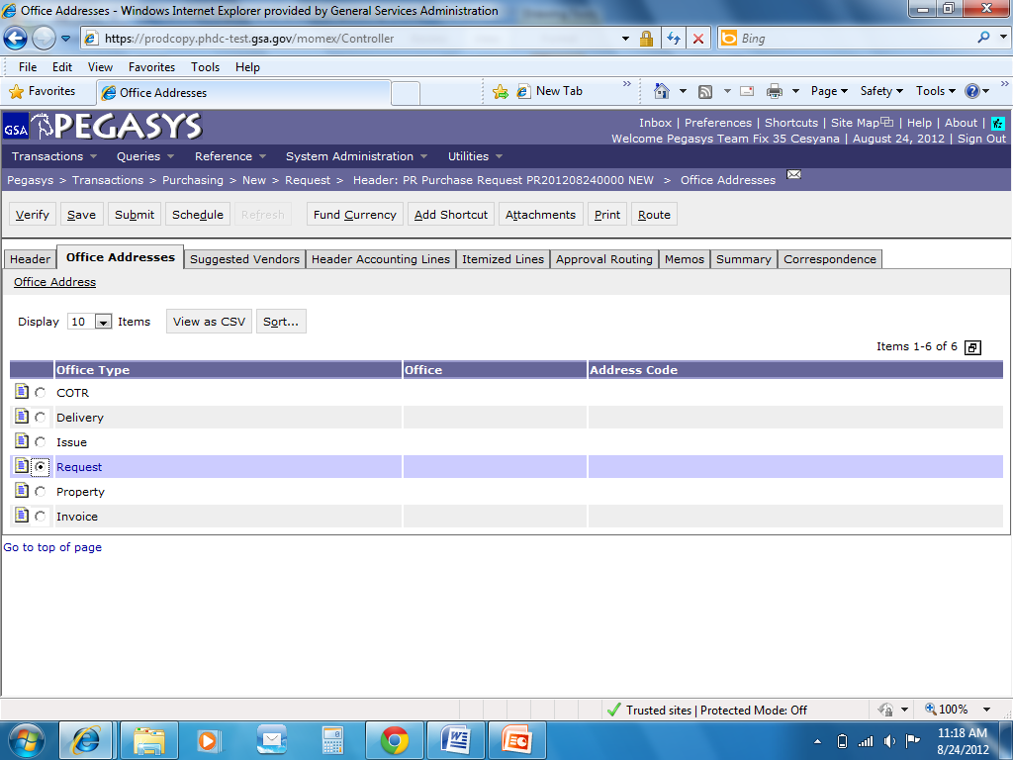
Office Addresses
Save Often
Click :
Office Addresses
Highlight :
Address line
Click :
- Office Address hyperlink
Required Addresses:
Delivery (2)
Issue (3)
Request (6)
Notes:
Delivery and Issue come from PR
Order is where the 2nd email will be sent prompting you for a receipt

Slide 9
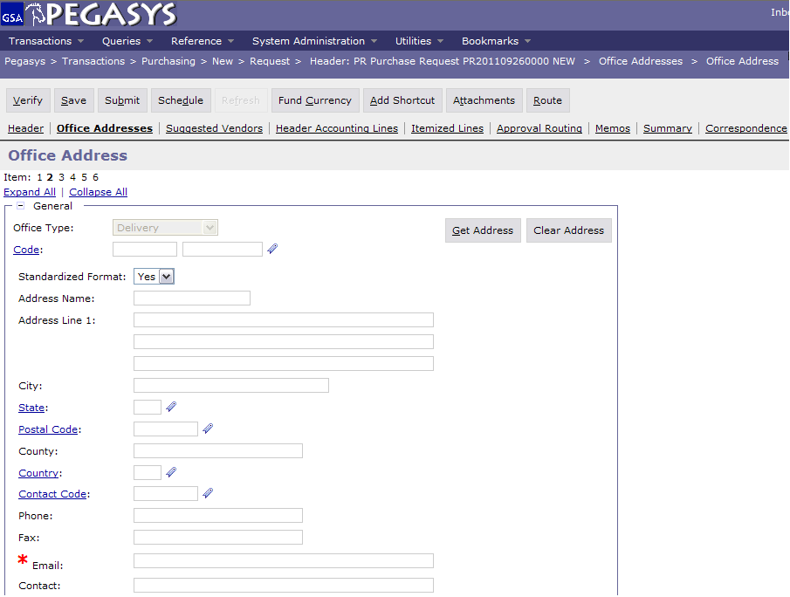
Office Addresses
Save Often
Click :
- Office addresses
Enter :
Code
or
- Type in Address
Enter Email
  For information on how to use office defaults, go to http://pegasys.gsa.gov/ref/howto.htm
Request for receipt is sent to this email
Notes:
Pegasys sends an email to solicit for a receipt, so put the receiver of the goods in the *Email field

Slide 10
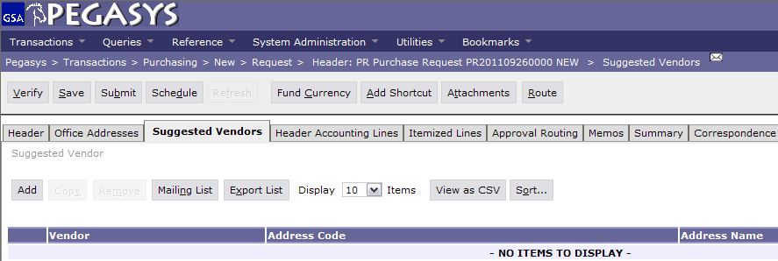
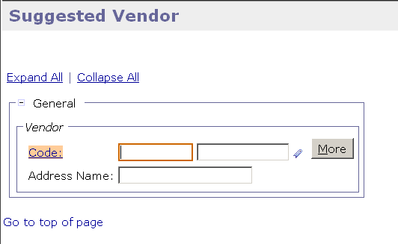
Suggested Vendors
Save Often
Suggested Vendors is Optional
You may choose any amount of vendors.
Click :
Suggested Vendors
Add
Code (in the Vendor box)
Notes:
This is OPTIONAL but you can add the contracting vendor by Suggested Vendor

Slide 11
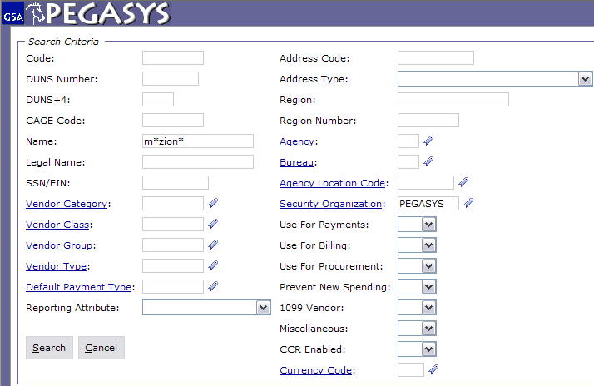
Vendor Code Search
Enter :
Code – Tax Identification Number (TIN)
or DUNS
or Name
*Intelligent*
Enter :
Pegasys (in Security Org)
The * is a wild card for searching
Notes:
Code is the TIN # (tax identification number)
Use wild card because Pegasys looks for an exact match Example: Inc does not equal Inc.
If the vendor isn’t in Pegasys then you can email the finance centers in FW and KC to get the vendor put in. Takes less then 24hrs

Slide 12
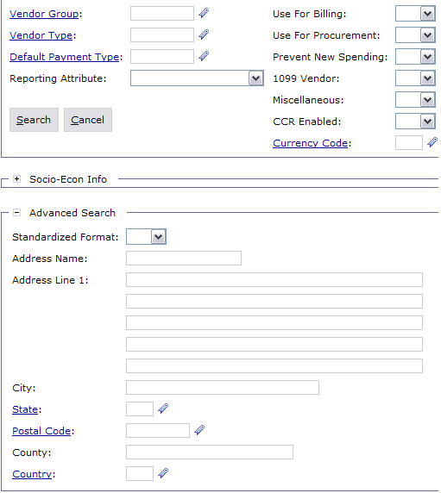
Vendor Advanced Search
To assist in narrowing down the search
Enter :
City and/or State
Click :
- Search

Slide 13
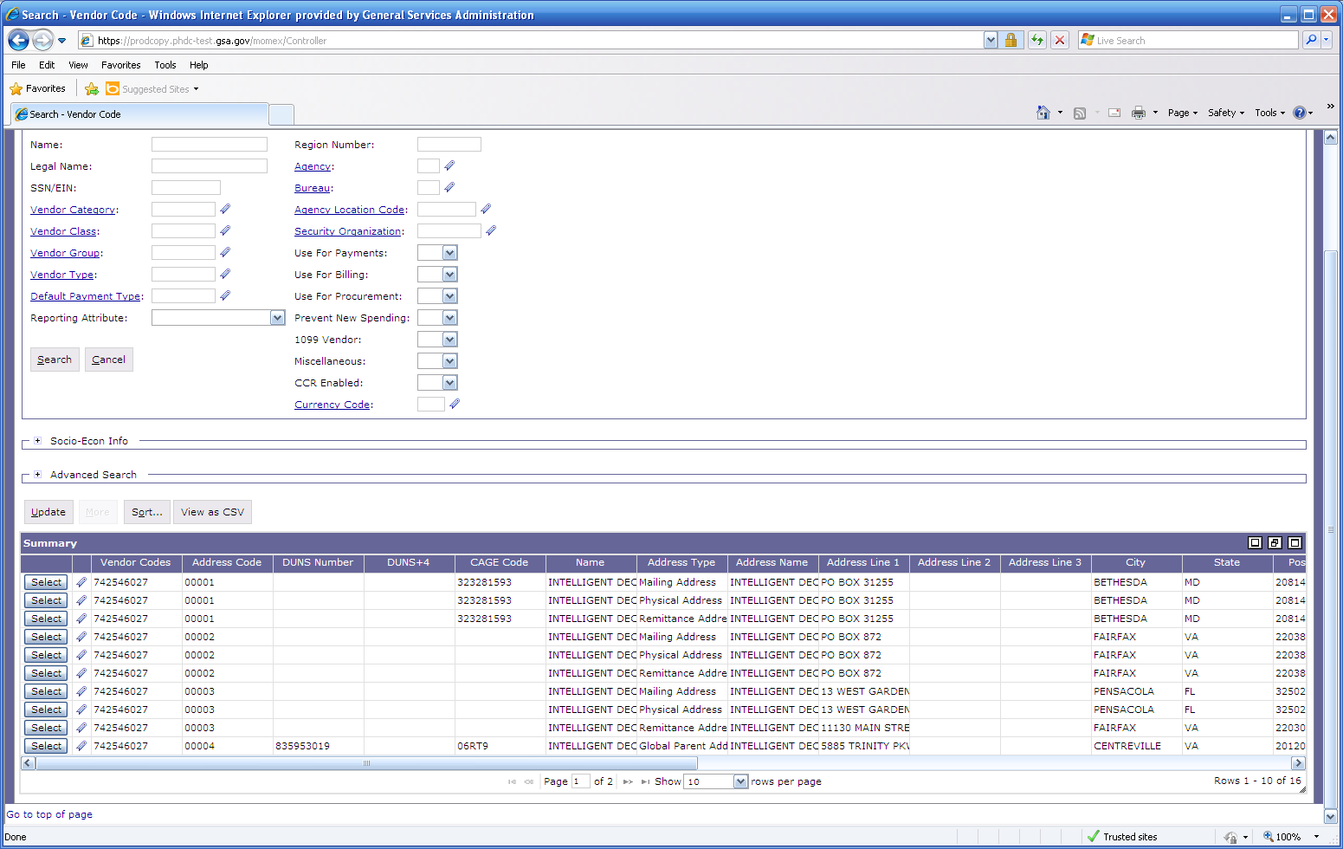

Vendor Results
Click on Favorites icon to save Vendor Address Code
Click Select
to populate field
https://finance3.gsa.gov/

Slide 14
Sample Accounting Templates
Accounting Template
2012
G
00
BD
262X
CST1
S00B0410
GM&A
FY
Service
Region
Corr. Symbol
Fund
Program
Org. Code
2012
P
00
192
P0010001
PG61
PBS
FY
Service
Region
Fund
Org. Code
Program
2012
A
00
285X
AF00
A0010100
AF372
_AdTravel
FAS
FY
Service
Region
Fund
Program
Org. Code
Activity

Slide 15
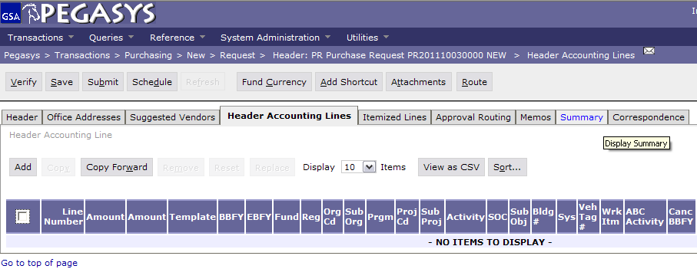
Header Accounting Lines
Save Often
Click :
- Header Accounting Lines
- Add

Slide 16
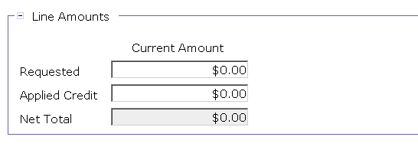
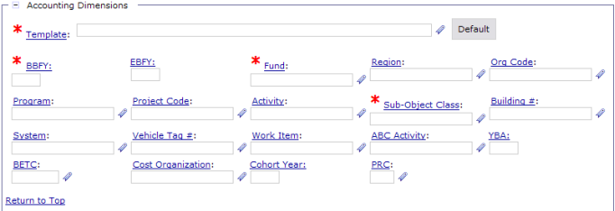

Header Accounting Line Tab
Enter :
- Line Amounts
Click :
Template
or
Click :
Favorites Icon
and
Click :
- Default

Slide 17
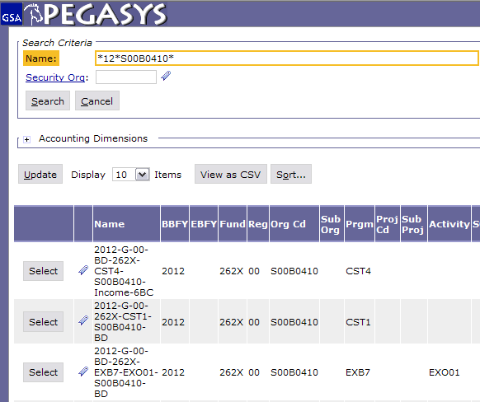

Header Accounting Line Tab (2)
- Type in the known information
- Click Search
- Add to the Favorites and select the correct string
The * is a wild card for searching
  For information on how to use favorites , go to http://pegasys.gsa.gov/ref/howto.htm

Slide 18
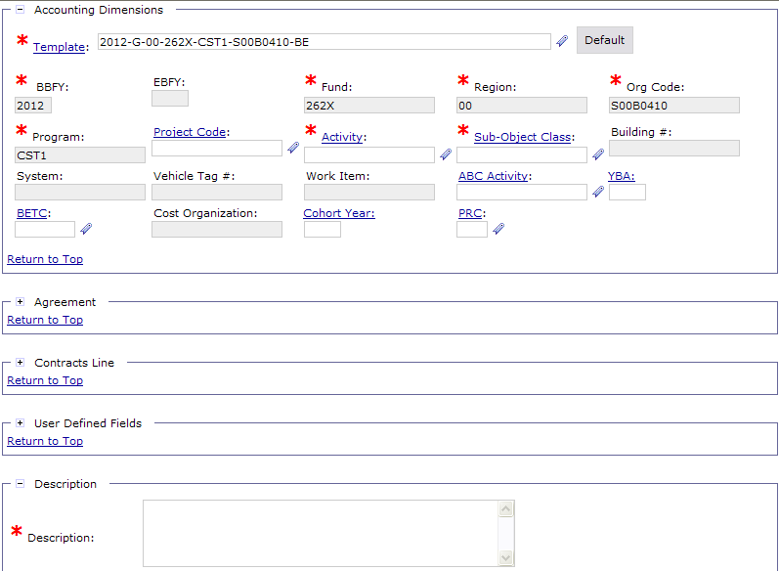
Header Accounting Line Tab (3)
Enter:
Activity
SOC
Note: Your accounting classification may require other data elements to be entered, such as BLDG Number, Work Item, Vehicle Tag #, Project Code, etc.

Slide 19
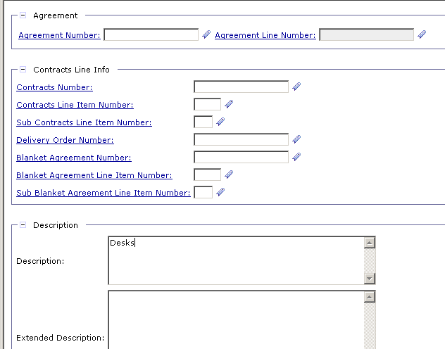
Header Accounting Line Tab (4)
PG80 ONLY
When entering RWA’s, use the Agreement Number Field.
Enter:
- Numbers only
- 1 (in the Agreement Line Number)
RWA - Reimbursable Work Authorization
Notes:
Agreement Number is the RWA number (PBS ONLY)
Drop alpha and add the number
If you have more than one accounting lines use the Description field to distinguish between them.

Slide 20
Description
Enter :
- Description
Notes:
Description is displayed on the Transaction Summary Report

Slide 21
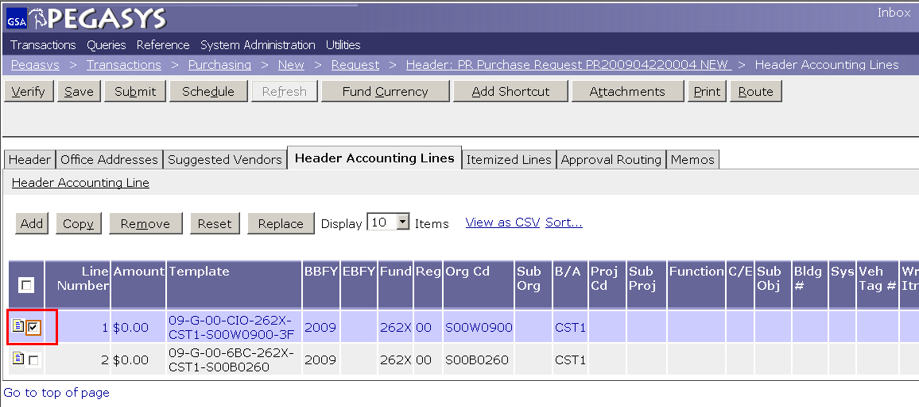
Multiple Lines
Save Often
Click :
- Add (then refer back to page 15)
or
Highlight
- Line
Click :
Copy
Header Accounting Line (hyperlink to make changes)
Notes:
DEMO:
Using the new Form from the previous example, on the Header Accounting Lines tab
Click the Add button to add a line
Click the Favorites icon for the Template field
Click the Search Link
Enter CC-192X-PG61-P032C300* in the Code Field
Click the Search button
Click Favorites icon to add to Favorites
Click the Cancel button
Back on the Form, display the newly created Favorite by clicking the Favorite icon for the Template field

Slide 22
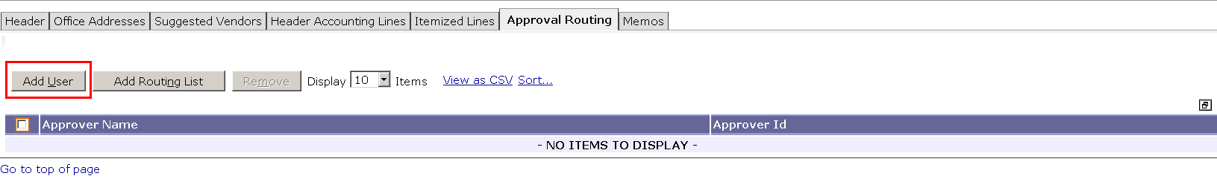
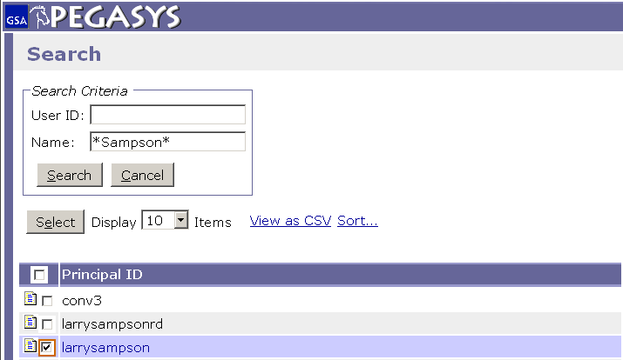
Approval Routing (Add User)
Approval Types for PR
  Purchase Manager
  Accounting Classification
  Funds Authorization
- Click Approval Routing
- Click Add User
- Enter Approver Name
- Click Search
Highlight Line
- Click Select
The * is a wild card for searching
Note: Repeat steps for each approver
Notes:
If the approver has a backup Pegasys will send to both. If one approves it, it will show up to the other as Acquired and won’t be accessible.

Slide 23
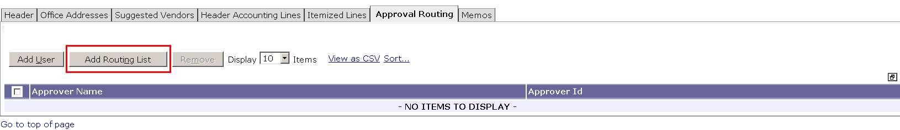
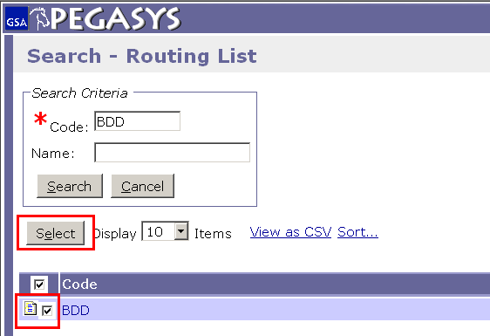
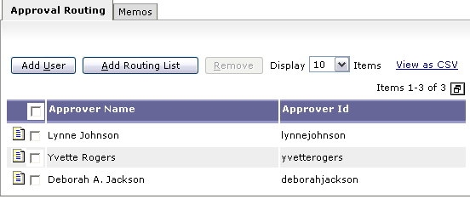
Approval Routing (Add Routing List)
- Click Add Routing List
- Enter Routing List Code
- Click Search
- Highlight Line
- Click Select
For more information on creating routing lists, go to http://pegasys.gsa.gov/docs/ref/qrc/6.5/RouteFormsQRC.pdf

Slide 24
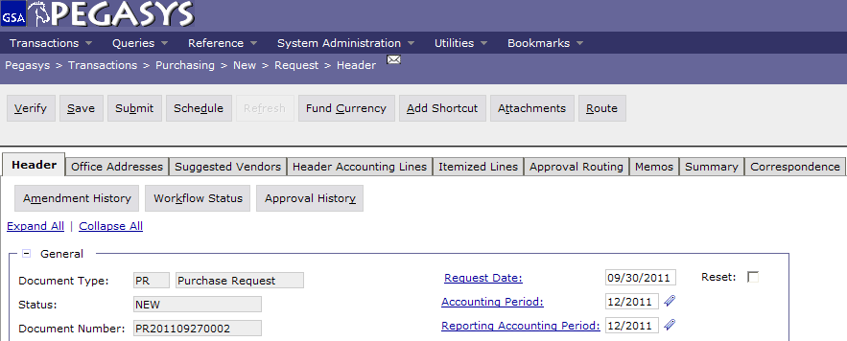
Save, Verify, Submit
  To finish the Form:
  - Save the form
  - Verify and correct any errors
  - Submit the document for approvals and processing

Slide 25
Purchase Requests - The Form becomes a Document
All approvals are applied
PR is forwarded to a Contracting Officer (CO)
CO creates a Purchase Order (PO)
  Obligation is established in Pegasys
  PO is sent to vendor
Goods are sent or services are rendered
Invoices submitted to Finance Center
Finance Center enters invoice in Pegasys
User processes Receipt
Notes:
Receipt based on goods that are physically here, or through email
Can do Receipt before Pegasys prompts you. If you get the goods and they are good then do the receipt!

Slide 26
Additional Assistance
Pegasys Web Site - http://pegasys.gsa.gov
  User Guides
  Quick Reference Cards
  Pegasys Training Classes
OCFO Consolidated Service Desk
  1-866-450-6588
  ocfoservicedesk@gsa.gov
ocfocustomerservice.gsa.gov
Notes:
If 90% of the time when you do a credit card it is same funding then set up the accounting string as a default.

Slide 27

Goals of Information Security
Confidentiality
  Data must be protected against unauthorized disclosure
Integrity
  Systems must not permit processes or data to be changed without authorization
Availability
  Systems must be functional and operational
Confidentiality
Availability
Integrity
Notes:
Please take a few moments and review the remaining slides on Information Security

Slide 28
Why is Information Security Important?
Must be in compliance with regulatory requirements such as OMB Circular A-130, Computer Security Act, FISMA and GSA IT security policies
Protects GSA information resources from potential abuse and misuse
Follows sound business practices

Slide 29
User Responsibility
Responsible for adherence to GSA information security policy
Protect Pegasys login ID and password
  Do not allow others to use your login ID / password
  Do not write it down
Log out whenever you are not using Pegasys
Protect sensitive information
  Shred reports containing sensitive information
Report security incidents
  Refer to OCFO Incident Handling Procedures for further guidance
  Report security incidents to your supervisor

Slide 30

Keys to Incident Prevention
Awareness - be aware of the value of the assets you are using to do your job and the nature of associated threats vulnerabilities and suspicious activities
Compliance - comply with established safeguards, policies, and processes
Common Sense - if something appears to be off, it generally is

Slide 31

Remember ...
Security is a PEOPLE issue,
not only a TECHNICAL one!

